Slide 1
Predicting growth conditions from omics data via machine learning
Umut Caglar UT Austin (Wilke Lab)

Slide 2
Q: Can we predict external conditions of bacteria growth by using machine learning technics?

Slide 3
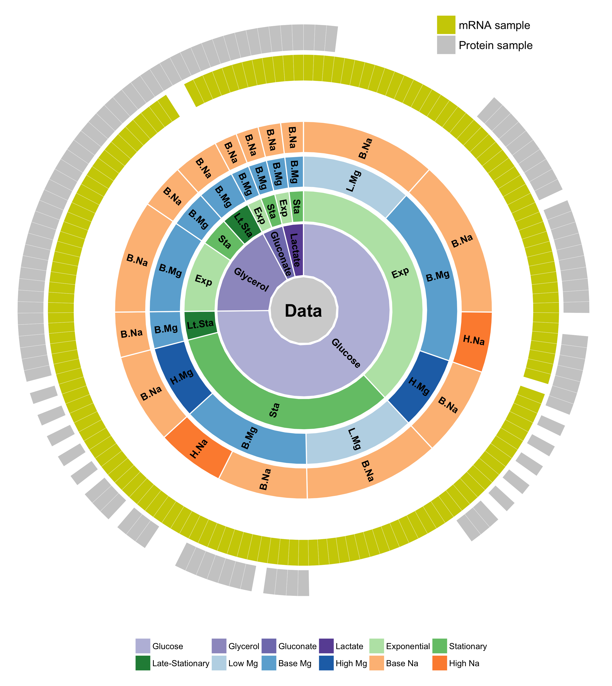
We have a large data set to learn bacterial response to external conditions

Slide 4
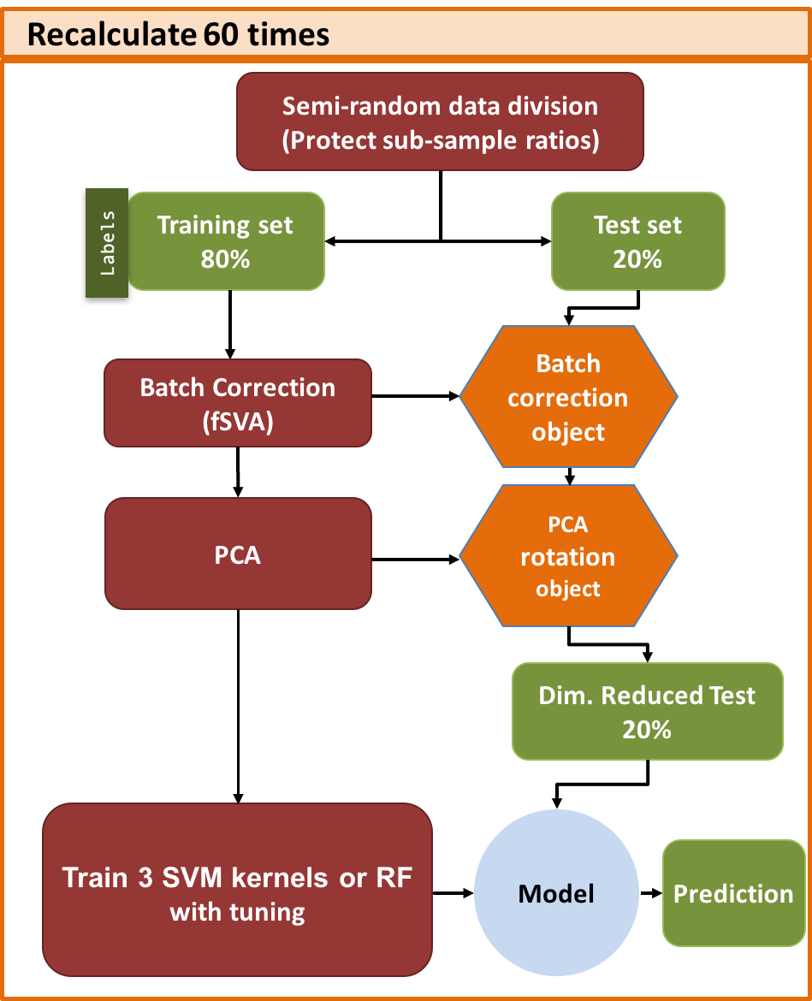
INITIAL DATA PREPERATION
DeSeq2, log transform.
SAMPLES
Labels
SVM Training with Tuning
Training set 80%
Labels
Semi-random data division
(Protect sub-sample ratios)
Training set 60%
Tune set 20%
Labels
3 SVM kernels or RF
Class weight normalization
Model
Parameter dependent prediction
Best
Model

Slide 5
INITIAL DATA PREPERATION
DeSeq2, log transform.
SAMPLES
Labels
SVM Training with Tuning
Training set 80%
Labels
Semi-random data division
(Protect sub-sample ratios)
Training set 60%
Tune set 20%
Labels
3 SVM kernels or RF
Class weight normalization
Model
Parameter dependent prediction
Best
Model

Slide 6
INITIAL DATA PREPERATION
DeSeq2, log transform.
SAMPLES
Labels
SVM Training with Tuning
Training set 80%
Labels
Semi-random data division
(Protect sub-sample ratios)
Training set 60%
Tune set 20%
Labels
3 SVM kernels or RF
Class weight normalization
Model
Parameter dependent prediction
Best
Model

Slide 7
Correct Metric is important
Pred True | A | B | C
A | 15 | 7 | 2
B | 11 | 45 | 1
C | 9 | 3 | 33
Confusion Matrix

Slide 8
Correct Metric is important
Pred True | A | B | C
A | 15 | 7 | 2
B | 11 | 45 | 1
C | 9 | 3 | 33
Confusion Matrix

Slide 9
Correct Metric is important
Pred True | A | B | C
A | 15 | 7 | 2
B | 11 | 45 | 1
C | 9 | 3 | 33
TP
FN
FP
Confusion Matrix

Slide 10
- What percent of the row “A” is on diagonal ? Recall = TP / (TP+FN)
Pred True | A | B | C
A | 15 | 7 | 2
B | 11 | 45 | 1
C | 9 | 3 | 33
TP
FN
FP
Confusion Matrix

Slide 11
- What percent of the column “A” is on diagonal ? Precision = TP / (TP+FP)
Pred True | A | B | C
A | 15 | 7 | 2
B | 11 | 45 | 1
C | 9 | 3 | 33
TP
FN
FP
Confusion Matrix

Slide 12
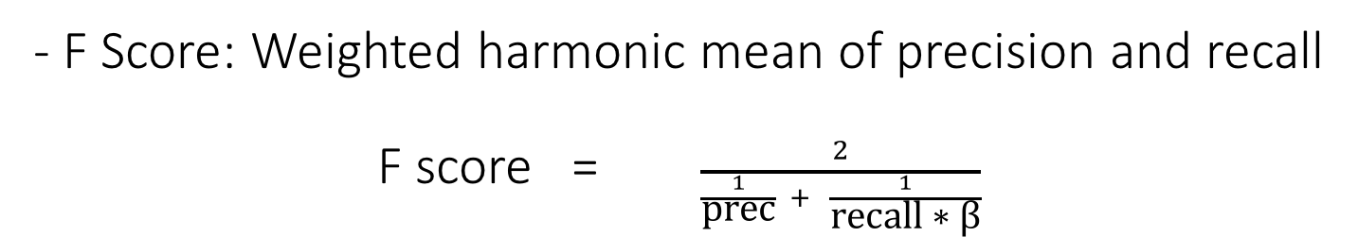
- F Score: Weighted harmonic mean of precision and recall F score = $\frac{2}{\frac{1}{\text{prec}} + \frac{1}{\text{recall}\text{ ∗ }\text{β}}}$
Pred True | A | B | C
A | 15 | 7 | 2
B | 11 | 45 | 1
C | 9 | 3 | 33
TP
FN
FP
Confusion Matrix

Slide 13
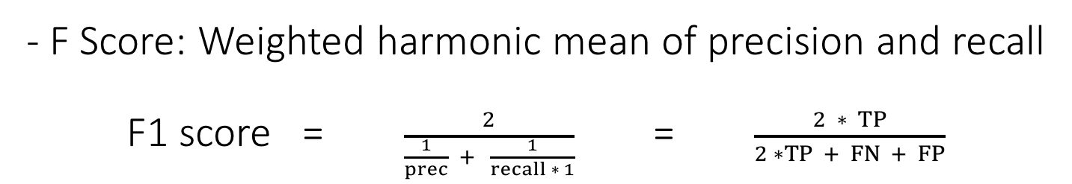
- F Score: Weighted harmonic mean of precision and recall F1 score = $\frac{2}{\frac{1}{prec} + \frac{1}{recall ∗ 1}}$ = $\frac{2 ∗ TP}{2 ∗TP + FN + FP}$
Pred True | A | B | C
A | 15 | 7 | 2
B | 11 | 45 | 1
C | 9 | 3 | 33
TP
FN
FP
Confusion Matrix

Slide 14
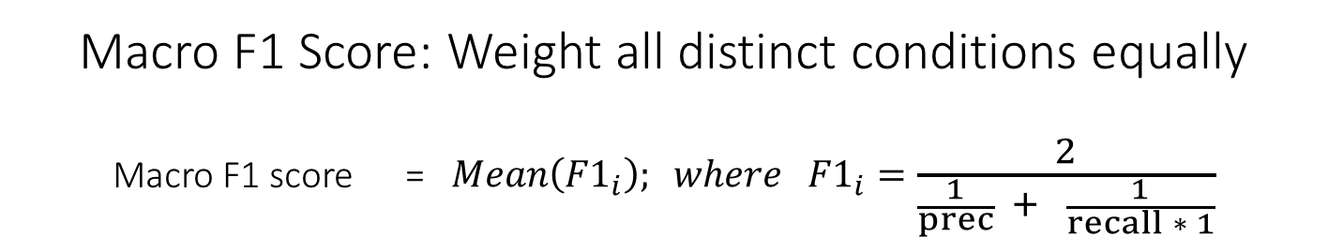
Macro F1 Score: Weight all distinct conditions equally Macro F1 score = $Mean\left({F1}_{i}\right); where{ F1}_{i}=\frac{2}{\frac{1}{prec} + \frac{1}{recall ∗ 1}}$
Pred True | A | B | C
A | 15 | 7 | 2
B | 11 | 45 | 1
C | 9 | 3 | 33
TP
FN
FP
Confusion Matrix

Slide 15
mRNA Results - Radial kernel

Slide 16
Protein Results - Sigmoidal kernel

Slide 17
Q: Can we predict external conditions of bacteria growth by using machine learning technics?
A:
Yes, and
it does not depend much on model, it depend on data type, and number of samples

Slide 18
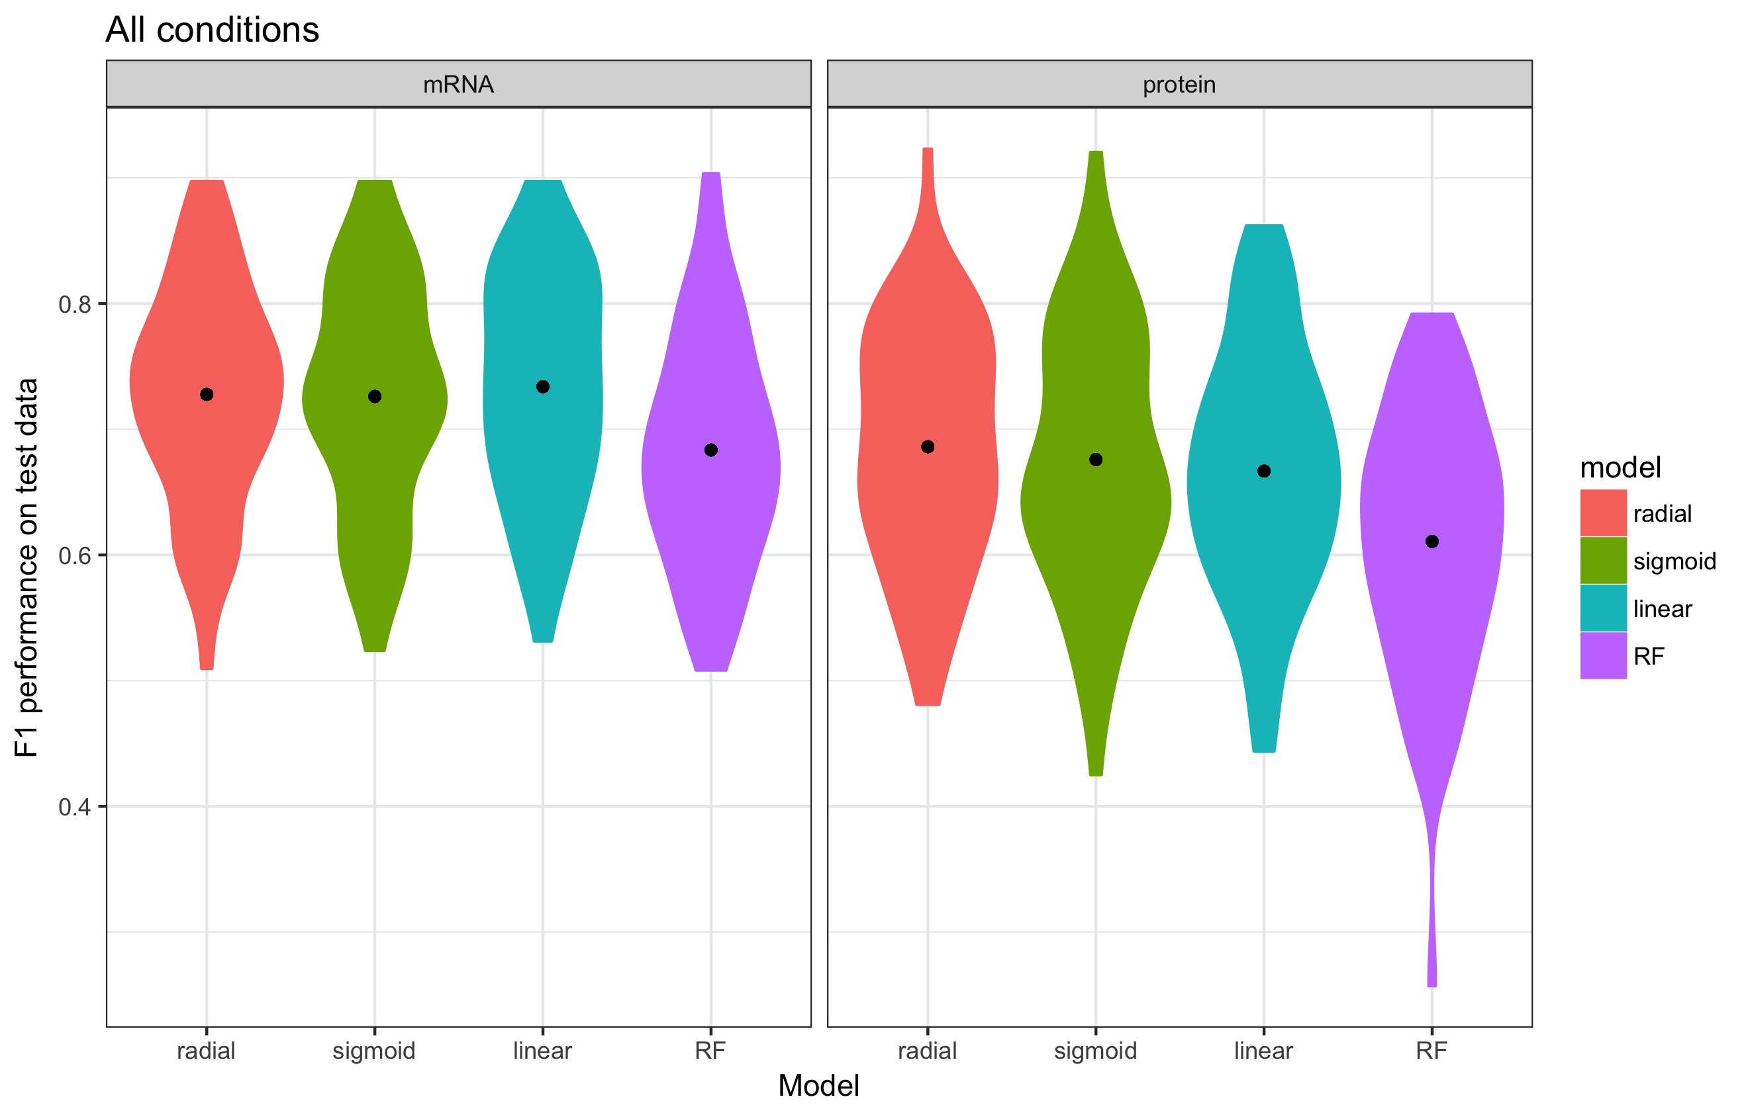
Results are comparable but mRNA have more samples

Slide 19
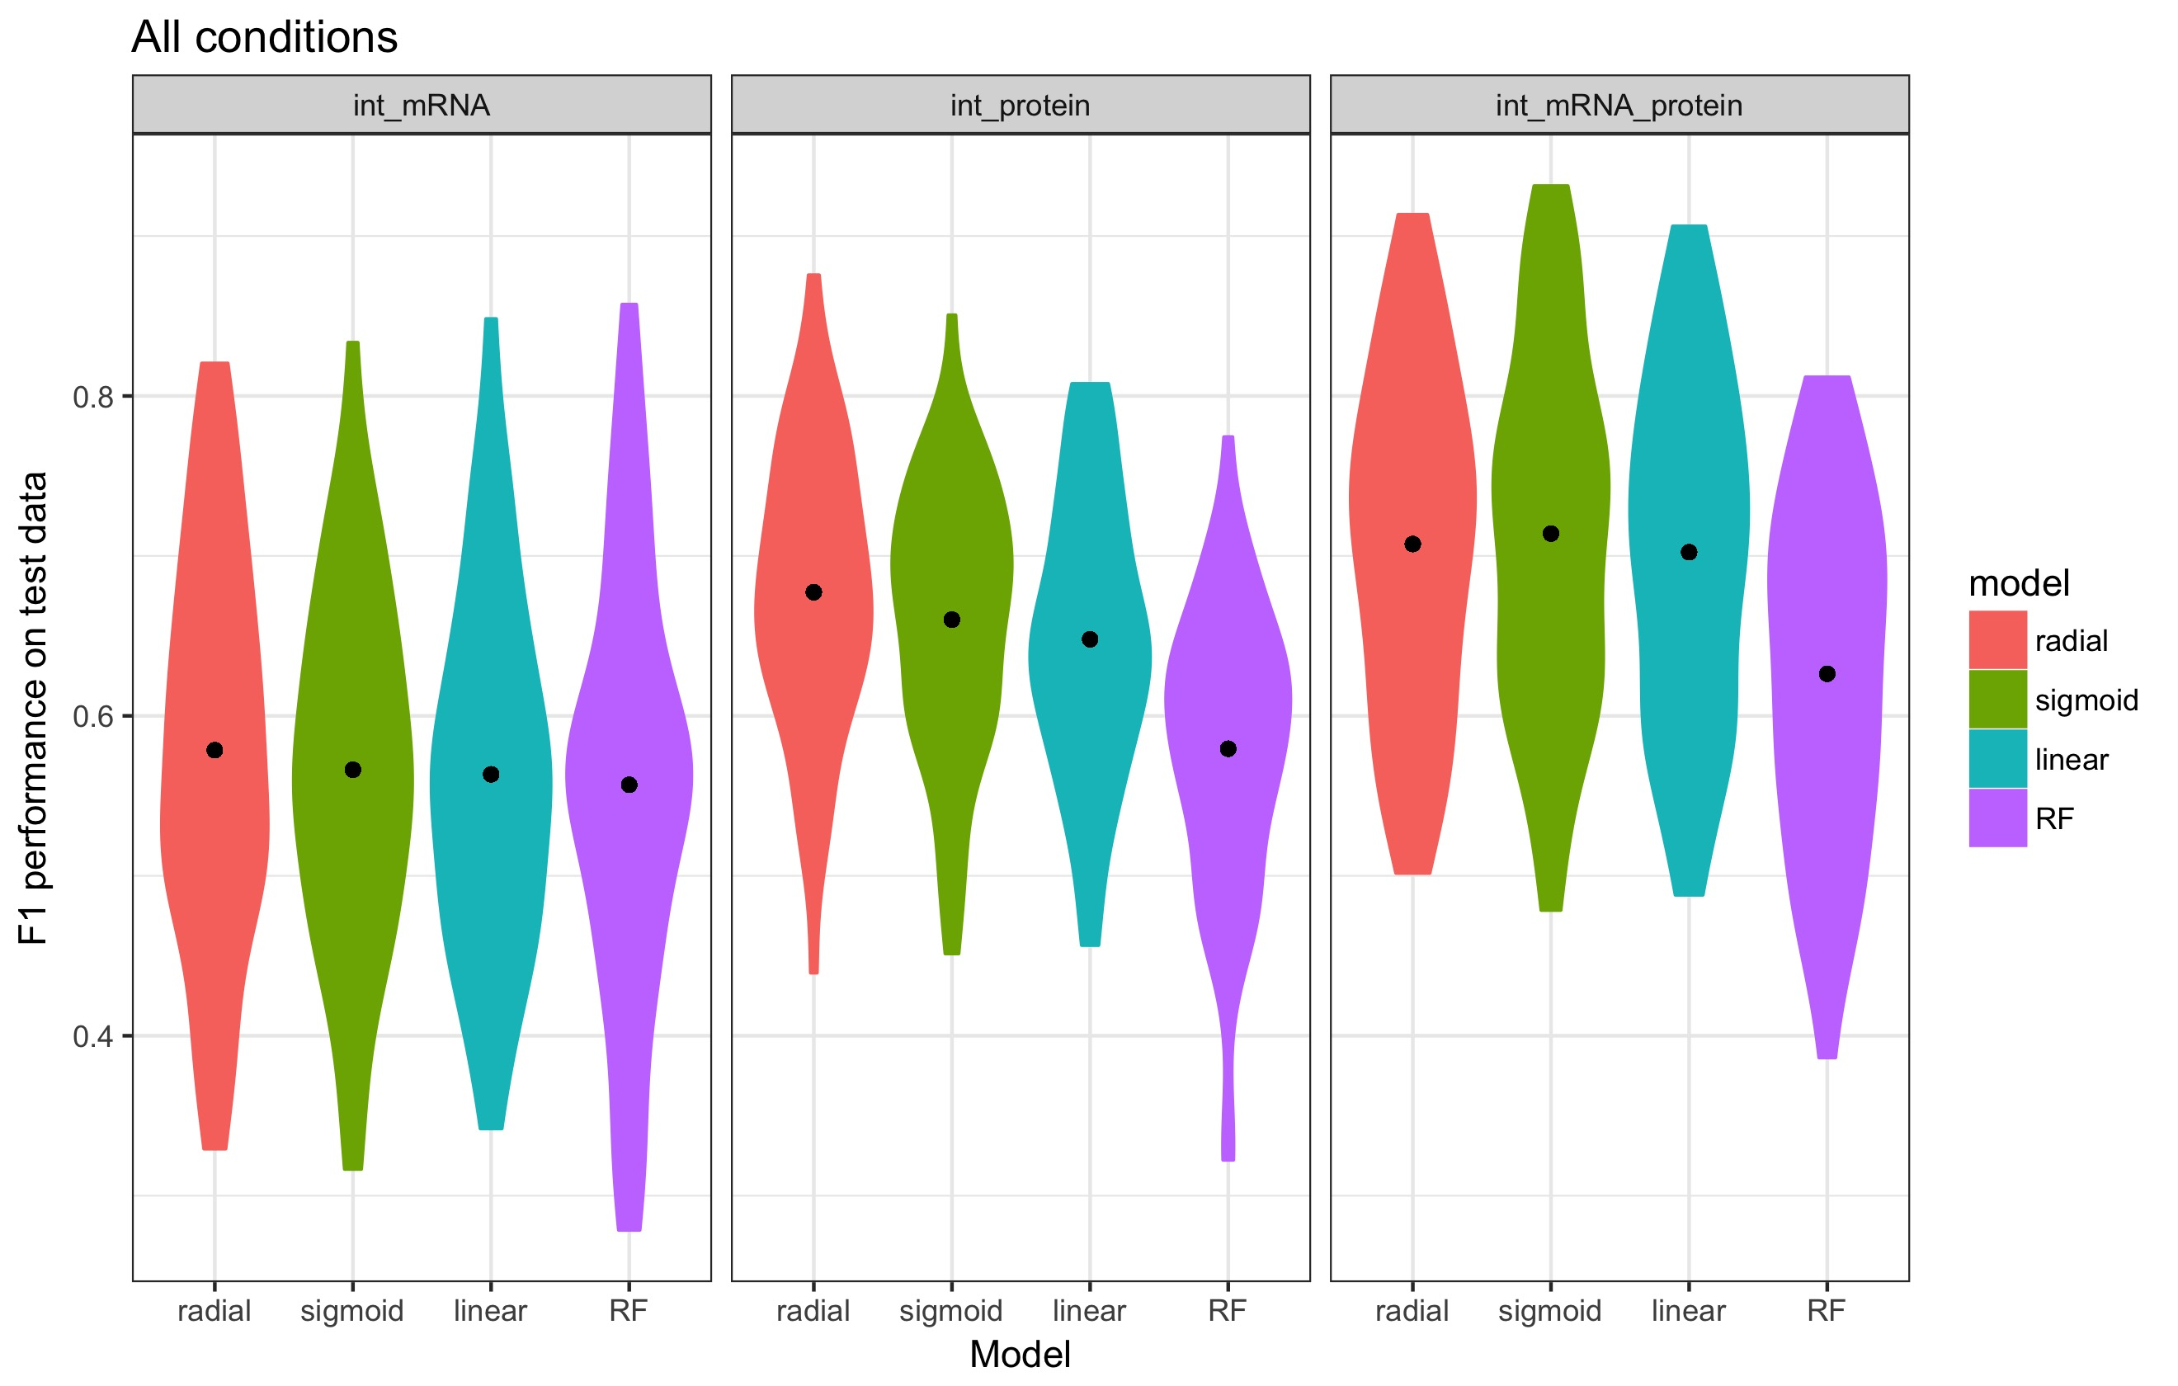
Combined > Protein > mRNA

Slide 20
A better approach needs more data
Protein data predicts A
mRNA data predicts B
Recall of A in protein
Recall of B in mRNA
Pick the better one
Precision = TP / (TP+FP)
Pred True | A | B | C
A | 15 | 7 | 2
B | 11 | 45 | 1
C | 9 | 3 | 33
TP
FN
FP

Slide 21
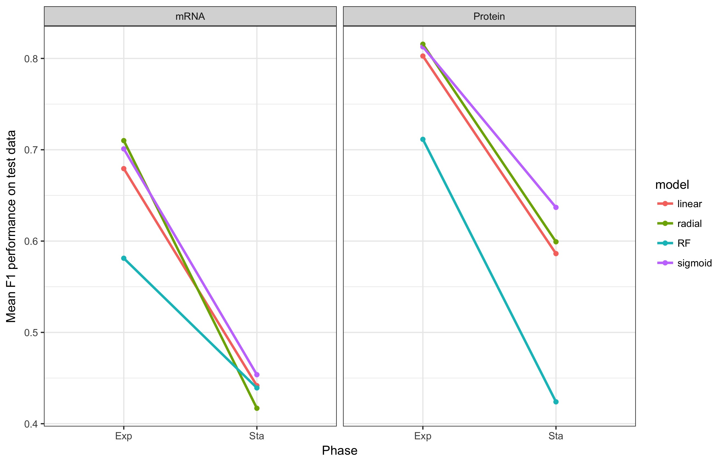
Predictability decreases between phases

Slide 22
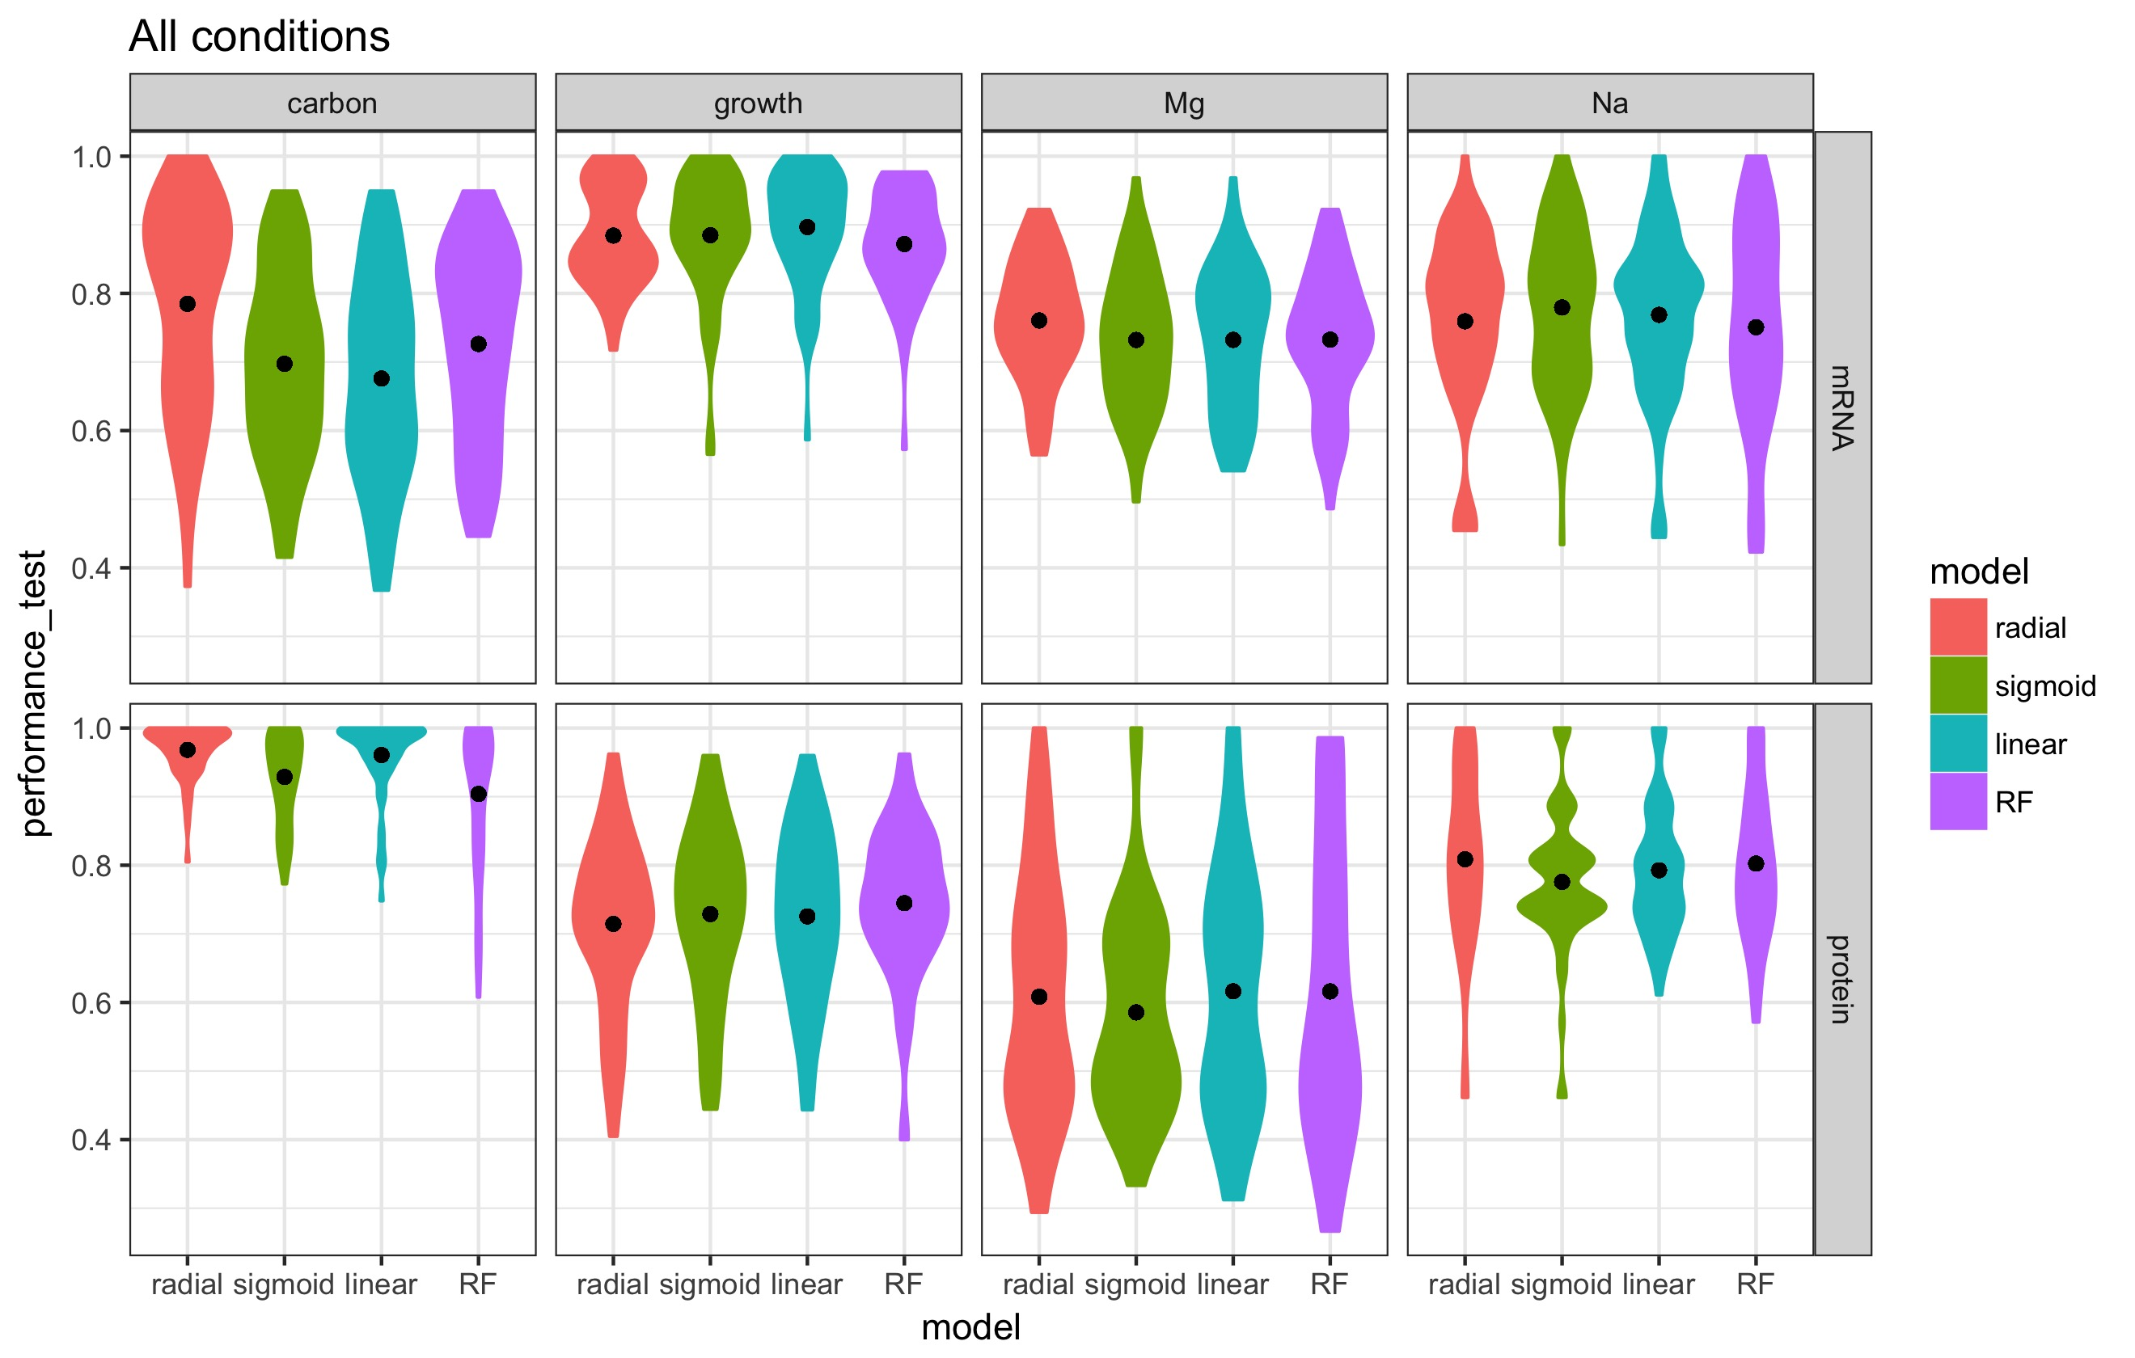
Predictability for individual conditions vary. Results are consistent with clustering of samples

Slide 23
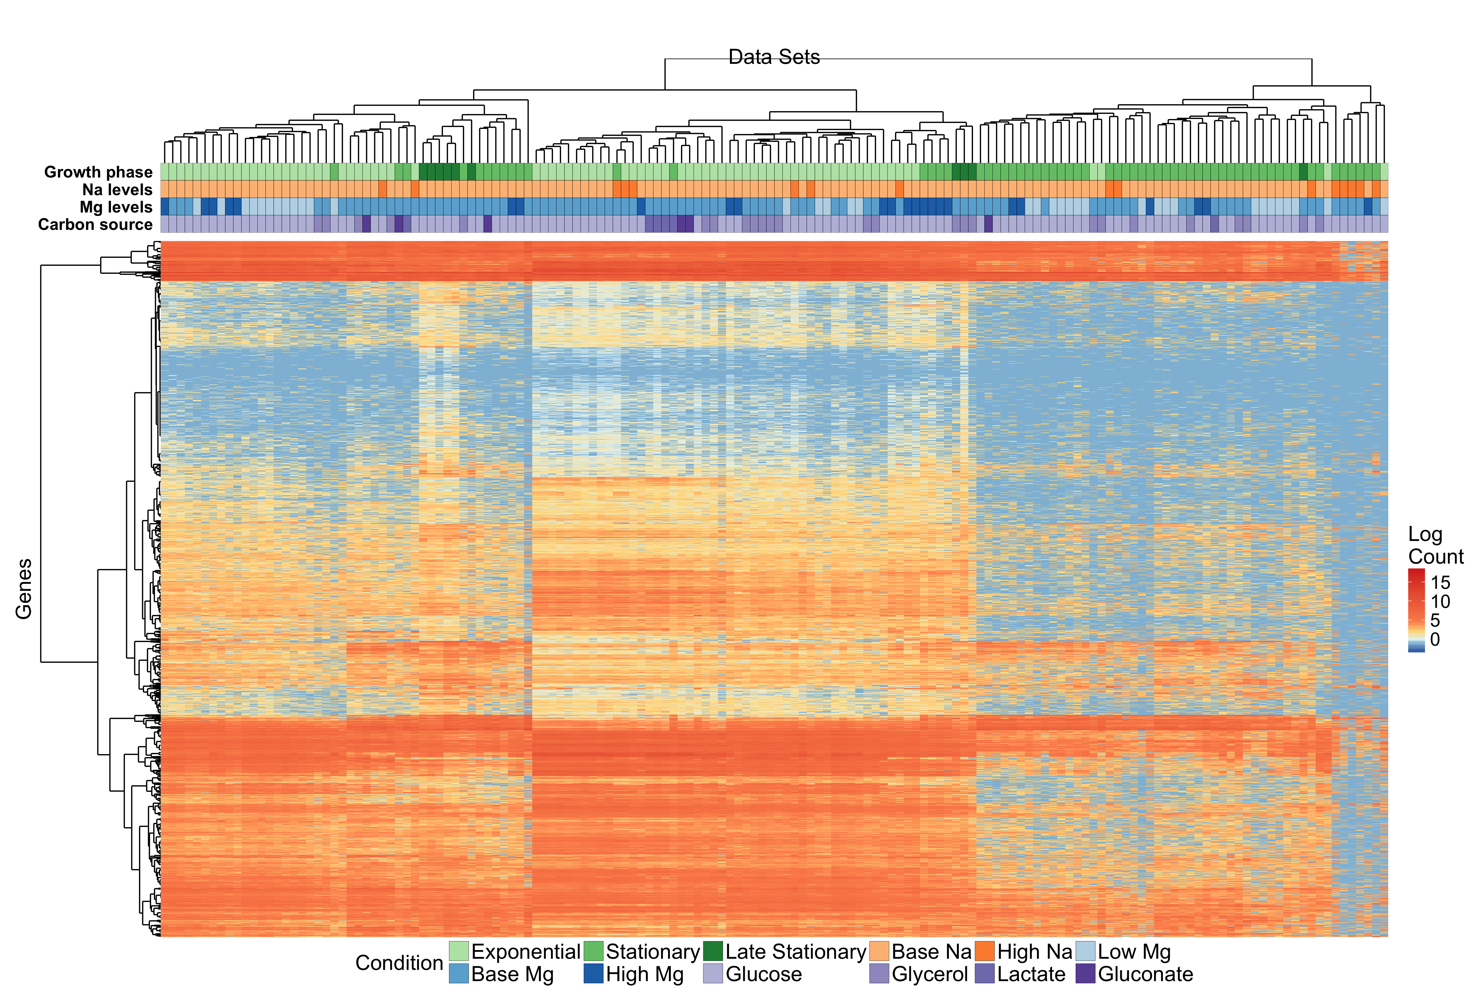
mRNA Clustering

Slide 24
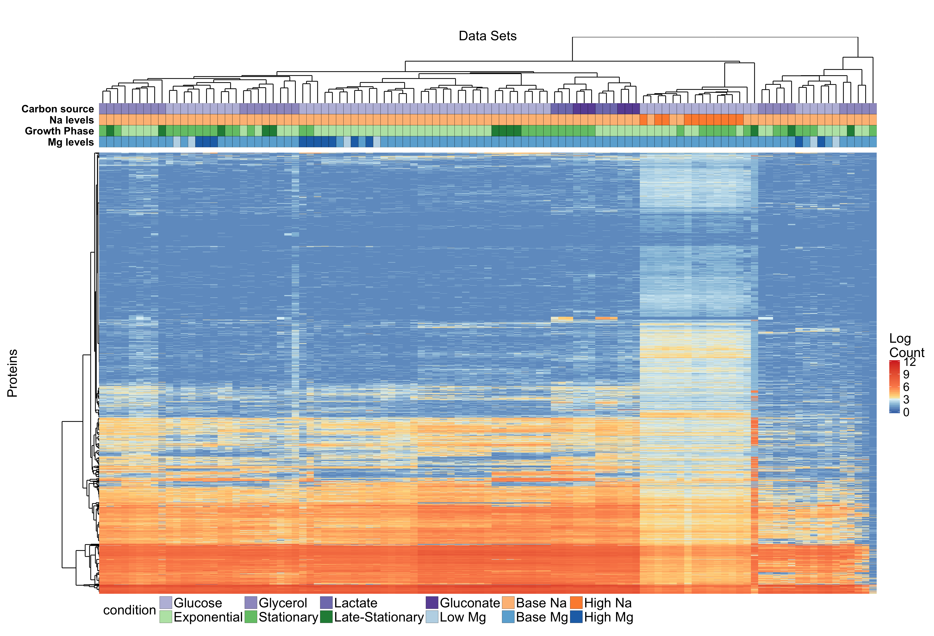
Protein Clustering

Slide 25
Z- scores tell the same story
Variable | Z score mRNA | Z score Protein
Growth phase | −30.98 | −1.27
Carbon source | 1.21 | −2.79
Mg Level | −3.21 | −0.50
Na Level | −1.89 | −1.74

Slide 26
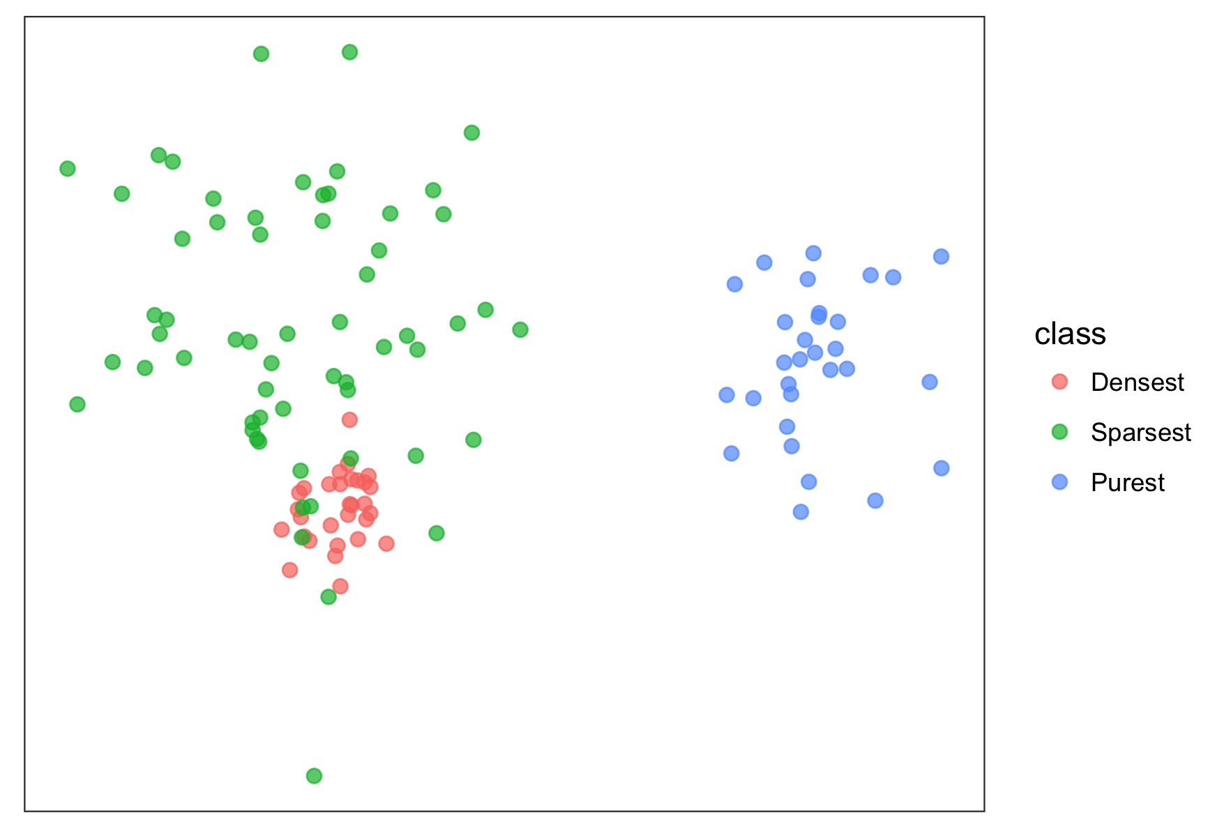
The cophenetic distance measures purity

Slide 27
Out of House Data
Schmidt, Alexander, et al. "The quantitative and condition-dependent Escherichia coli proteome." Nature biotechnology 34.1 (2016): 104-110.

Slide 28
5 triplet samples that match to our experiment
Glucose (Exponential phase, no osmotic stress)
Glycerol (Exponential phase, no osmotic stress)
50 mm Na (Exponential phase) *In our experiment have Na levels of 5, 100, 200, 300 mm; where all except 5mm is labelled as high Na
Stationary phase (Glucose, no osmotic stress, 24 hours) *In our experiment 24 and 48 hours are labelled as stationary
Late-stationary phase (Glucose, no osmotic stress, 72 hours) *In our experiment 24 ,48 hours are labelled as stationary and 168, 336 hours are labeled as late-stationary

Slide 29
Fewer proteins were covered in the study, that results in two distinct approaches. 4196 vs 1722 Proteins
Add synthetic data for missing parts
Remove actual data

Slide 30
Add synthetic data for missing parts
SAMPLES
TRAINING DATA
PROTEIN ABOUNDANCES
TEST DATA

Slide 31
Add synthetic data for missing parts; predictions
Test |  | Predictions
 |  | Na level | Mg Level | Carbon source | Phase
Glucose |  | base Na | high Mg | Glucose | Exponential
Glycerol |  | base Na | high Mg | Glucose* | Exponential
Na 50 Stress |  | base Na* | high Mg | Glucose | Exponential
Stationary |  | base Na | base Mg | Glucose | Stationary*
Late stationary |  | base Na | base Mg | Glucose | Stationary*
This approach have a bias toward conditions with more samples

Slide 32
Remove actual data from training
SAMPLES
TRAINING DATA
TEST DATA
PROTEIN ABOUNDANCES

Slide 33
Add synthetic data for missing parts; predictions
Test |  | Predictions
 |  | Na level | Mg Level | Carbon source | Phase
Glucose |  | base Na | base Mg | Gluconate | Exponential
Glycerol |  | base Na | base Mg | Gluconate* | Exponential
Na 50 Stress |  | High Na* | base Mg | Glucose | Exponential
Stationary |  | base Na | base Mg | Glucose | Stationary*
Late stationary |  | base Na | base Mg | Glucose | Stationary*

Slide 34
Now I will try nearest neighbor approach

Slide 35
What was the performance for our data
Predicted
X
True

Slide 36
Problems: Sample size still have an effect

Slide 37
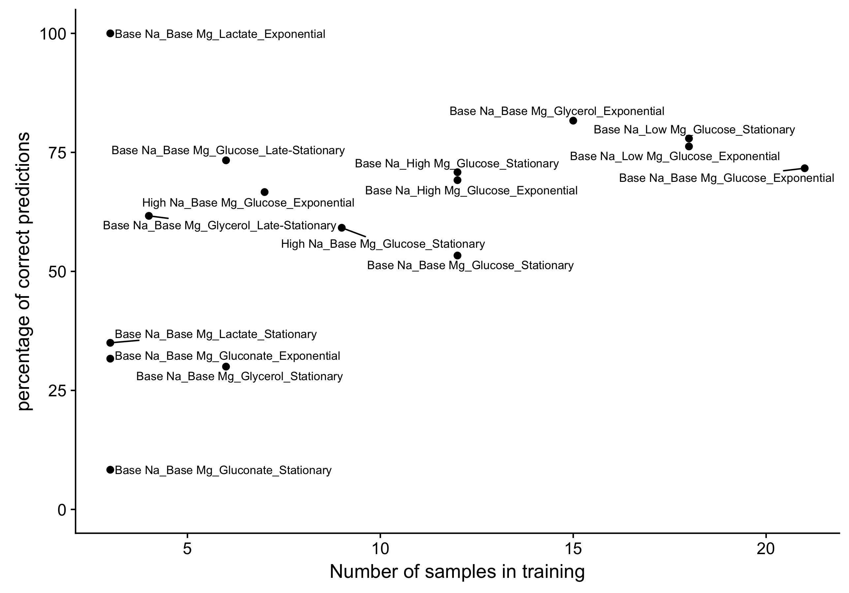
Mostly solved but still have problems

Slide 38
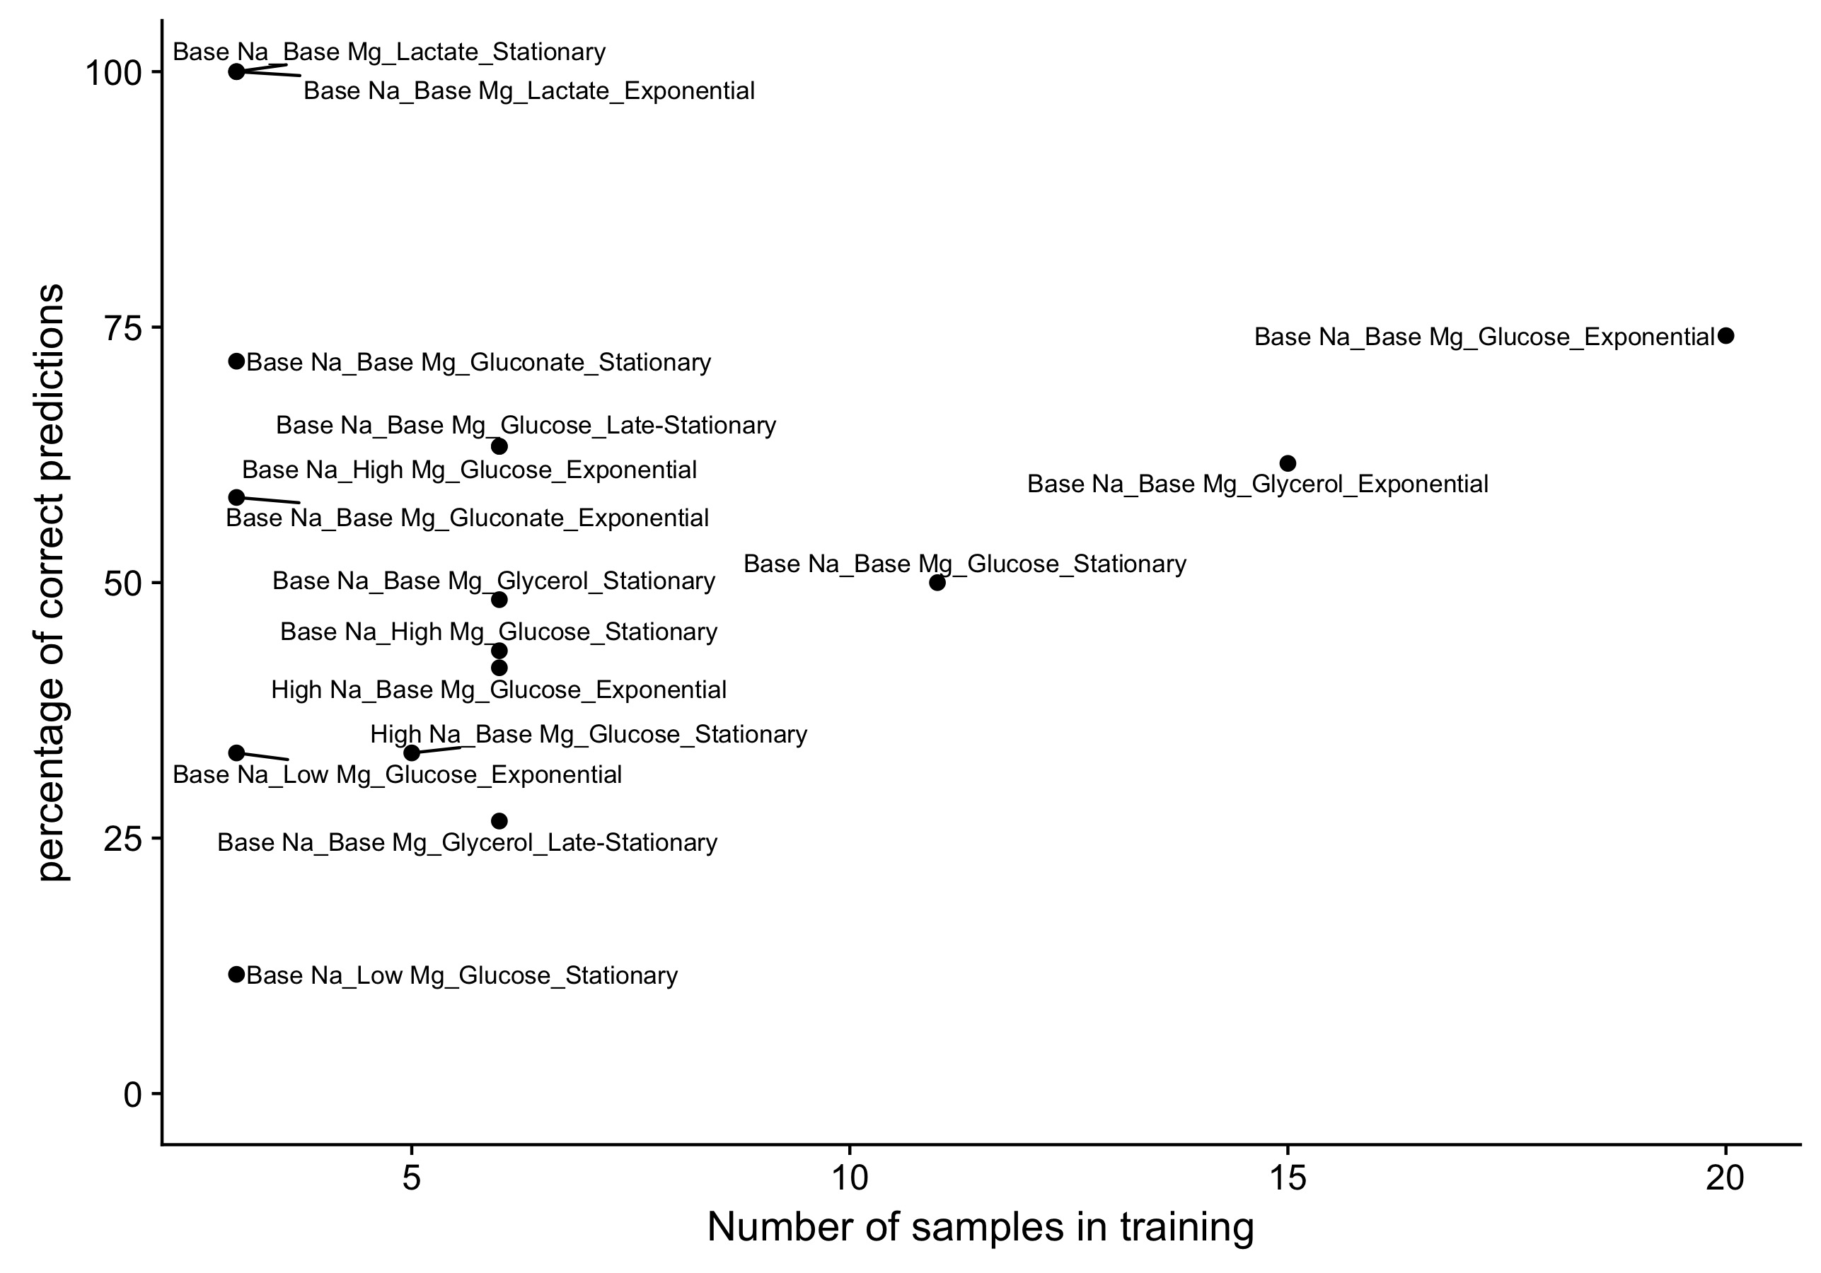
Mostly solved but still have problems

